Slide 1
Building a Secure and Decentralized Messaging App with Actor-Based Communication on the Blockchain

Slide 2
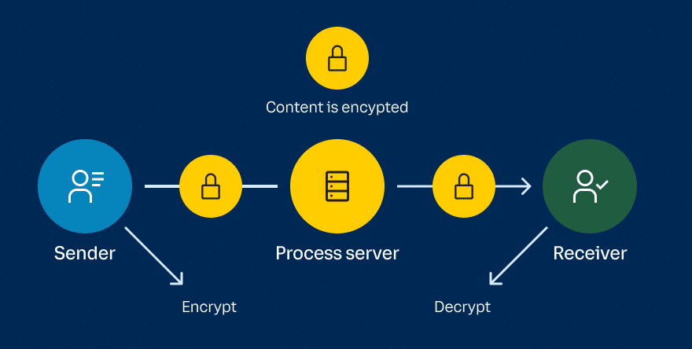
Essential Properties of the Messaging DApp
End-to-End Encryption
Decentralization
User Data Ownership
Censorship Resistance
Immutable Message History
Scalability
Cost-Efficiency
User-Friendly Interface
Security and Auditing

Slide 3
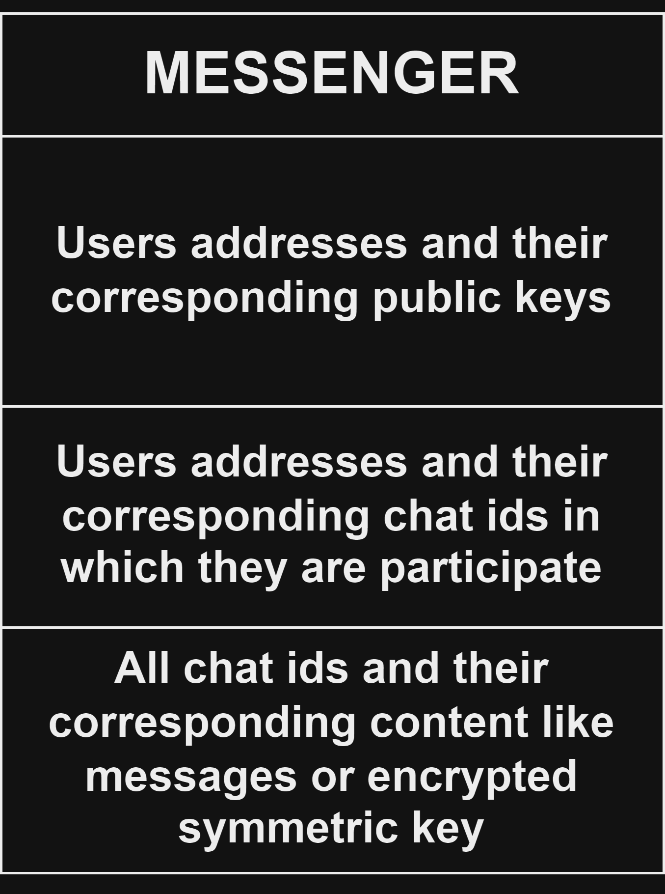
All in one contract implementation
The whole implementation of messenger in one contract Benefits:
it is much easier to prove that everything works as it is written in the documentation and there are no inconsistencies
we can modify the contract in such a way that no one can find out who communicates with whom
Disadvantages:
since the smart contract can only execute one message at a time, everyone will have to wait in line for each other
the risk of DDoS attacks increases significantly (from previous point)
smart contract memory can be limited (but this is not a big problem since we can just create a new one and have them refer to each other)

Slide 4
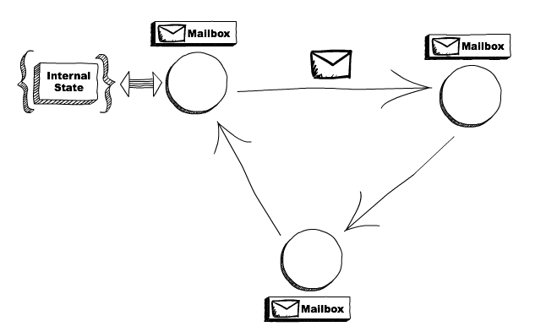
Actor-Based Communication
In traditional software design, communication between components often follows a centralized or client-server model
Actor-Based Communication:
An actor is a computational entity that, in response to a message it receives, can concurrently:
send a finite number of messages to other actors
create a finite number of new actors
designate the behavior to be used for the next message it receives
There is no assumed sequence to the above actions and they could be carried out in parallel.

Slide 5
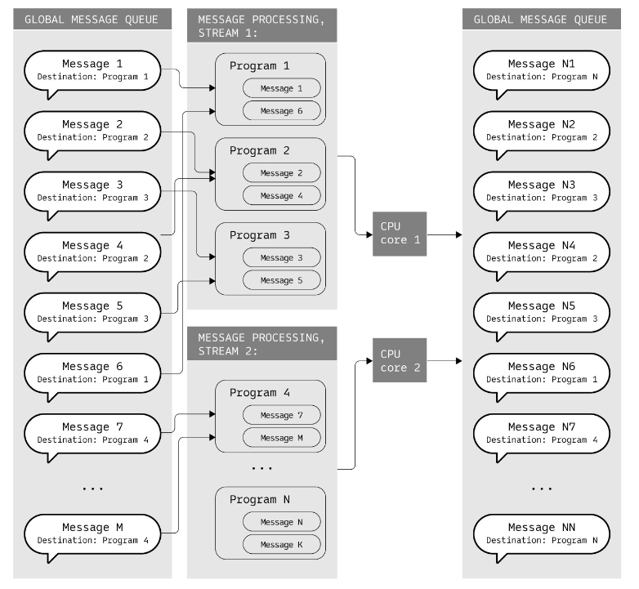
Gear Protocol allocates isolated memory space for each program. Programs cannot access each other's memory
Messages are divided into multiple streams for parallel processing
Parallel streams allow nodes to efficiently utilize multi-core hardware
If the blockchain system provides nodes with the ability to execute messages in parallel, then it will be very beneficial for us to make our messenger distributed, as this will greatly reduce the waiting time for message processing

Slide 6
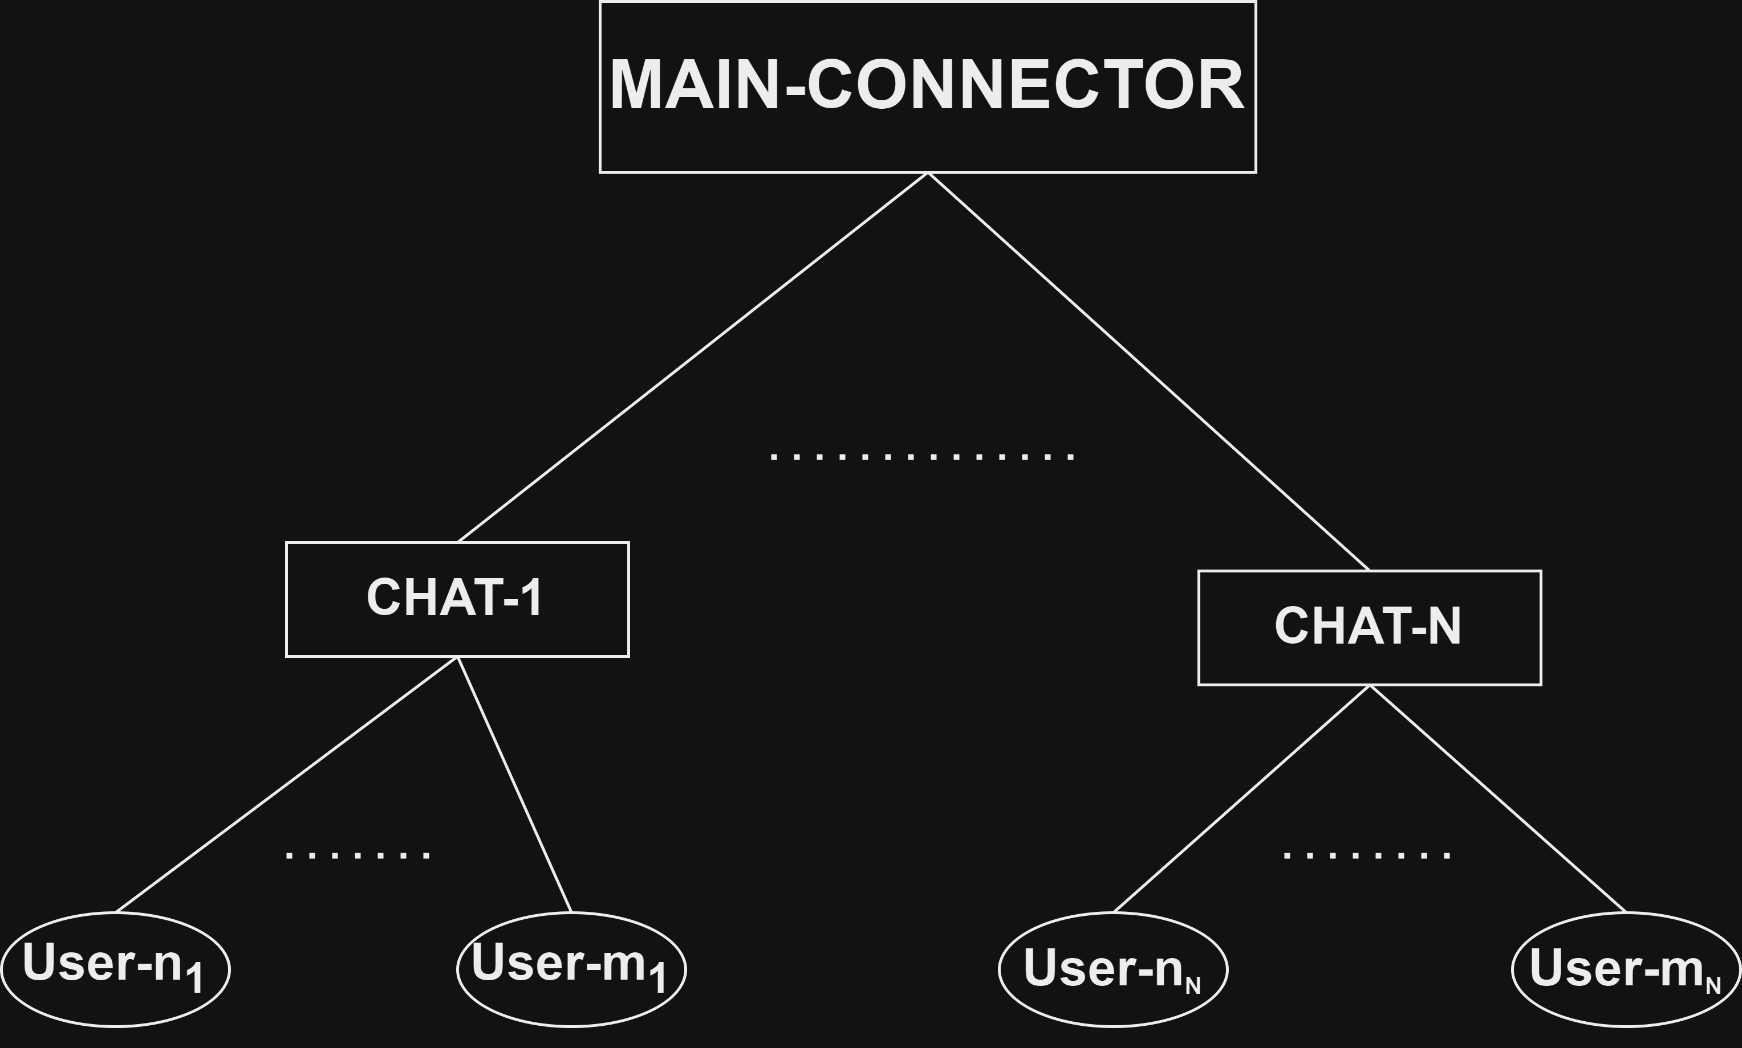
distributed messenger with central Main contract creator
Benefits of distributed Messaging Dapp :
Enhanced Security: Actor-based communication minimizes attack vectors, reducing potential vulnerabilities
Scalability: Actor-based architecture enables efficient parallel processing of transactions, improving performance
Privacy: Messages are end-to-end encrypted, ensuring confidentiality and protecting user data
Decentralization: The absence of a central authority empowers users and promotes censorship resistance
User Control: Users have ownership of their data and cryptographic identities, promoting data sovereignty

Slide 7
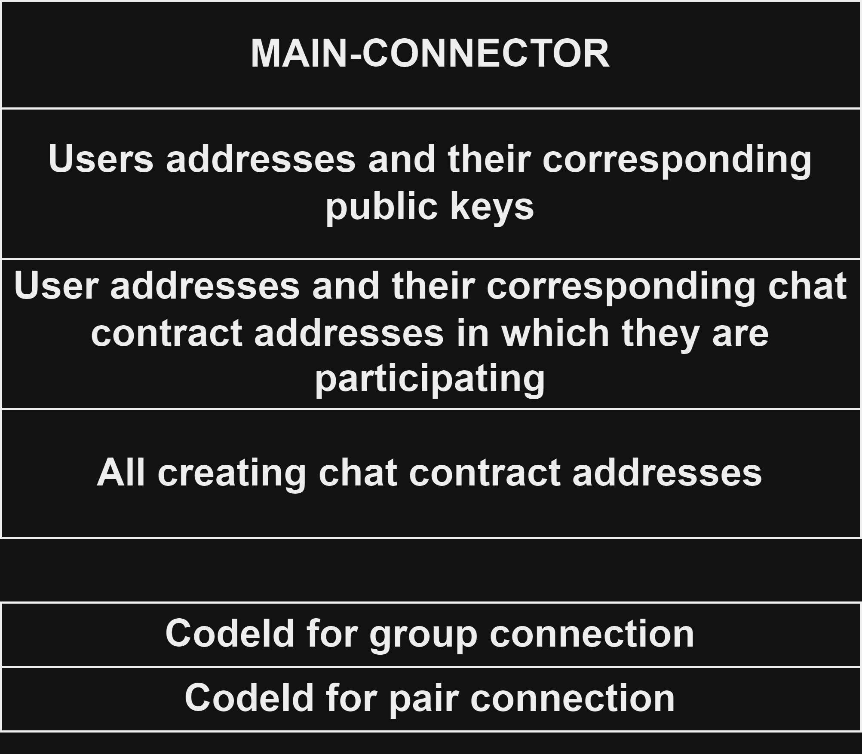
Main connector
Functionality:
Register user public key:
User just sends his public key
Create new group chat:
User send generated by him encrypted symmetric key for future created chat
Create new pair chat:
User send symmetric key encrypted by his public key and by public key of user with which he wants to start communication and address of that user
Add user in the chat:
Can only be sent by chats themselves (so, if user want to add another user in the chat he must send it to the chat, and chat in its turn send it to MAIN-CONNECTOR)
So if MAIN-CONNECTOR didn’t create this chat then it panic

Slide 8
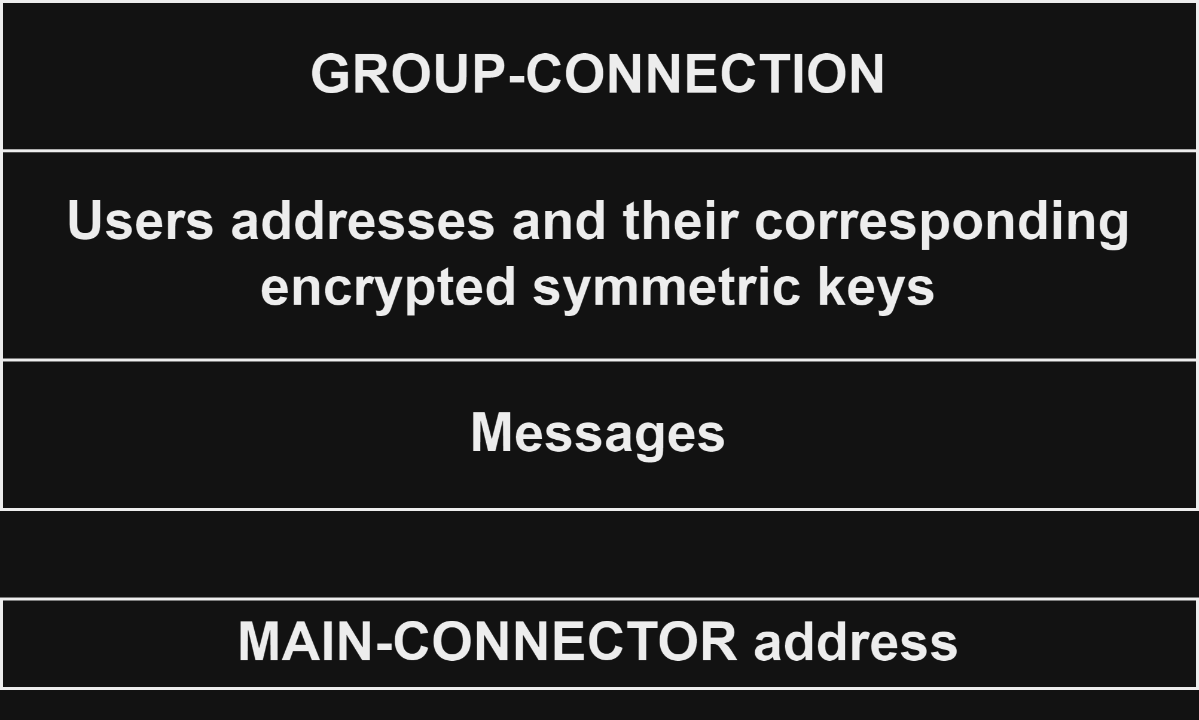
Group connection
Functionality:
Add new user:
The from chat can add another user, he must send symmetric key for chat encrypted by public key of adding user and the address of user itself
Chat in its turn send appropriate message to MAIN-CONNECTOR
Send message:
User from chat send message encrypted by symmetric key for that chat
Mark as read
Send link to data on IPFS
Delete message

Slide 9
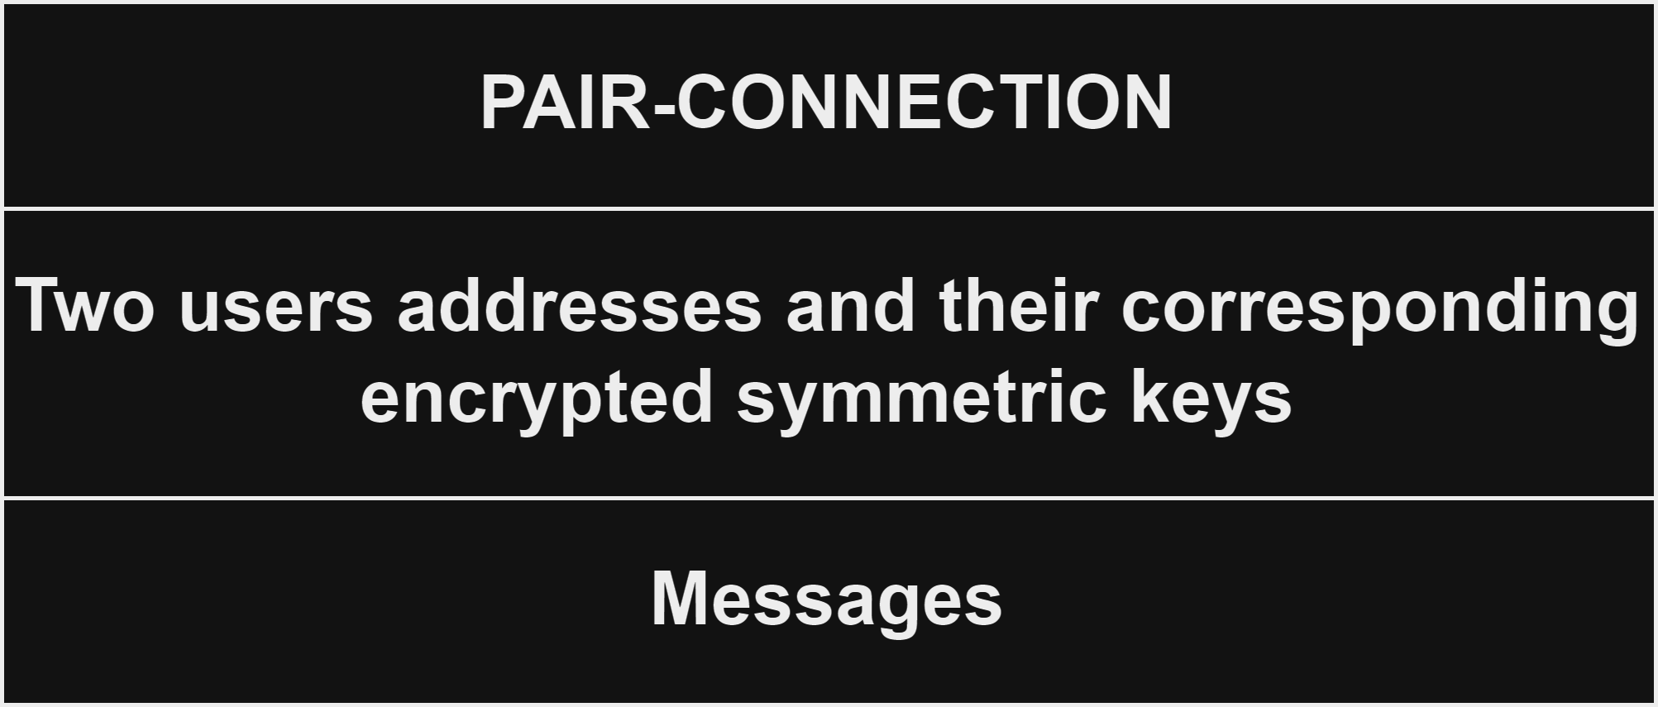
Pair-connection
Functionality:
Send message: Check that user is in the chat
PAIR-CONNECTION lives on its own, we don’t need send any messages from it to MAIN-CONNECTOR

Slide 10
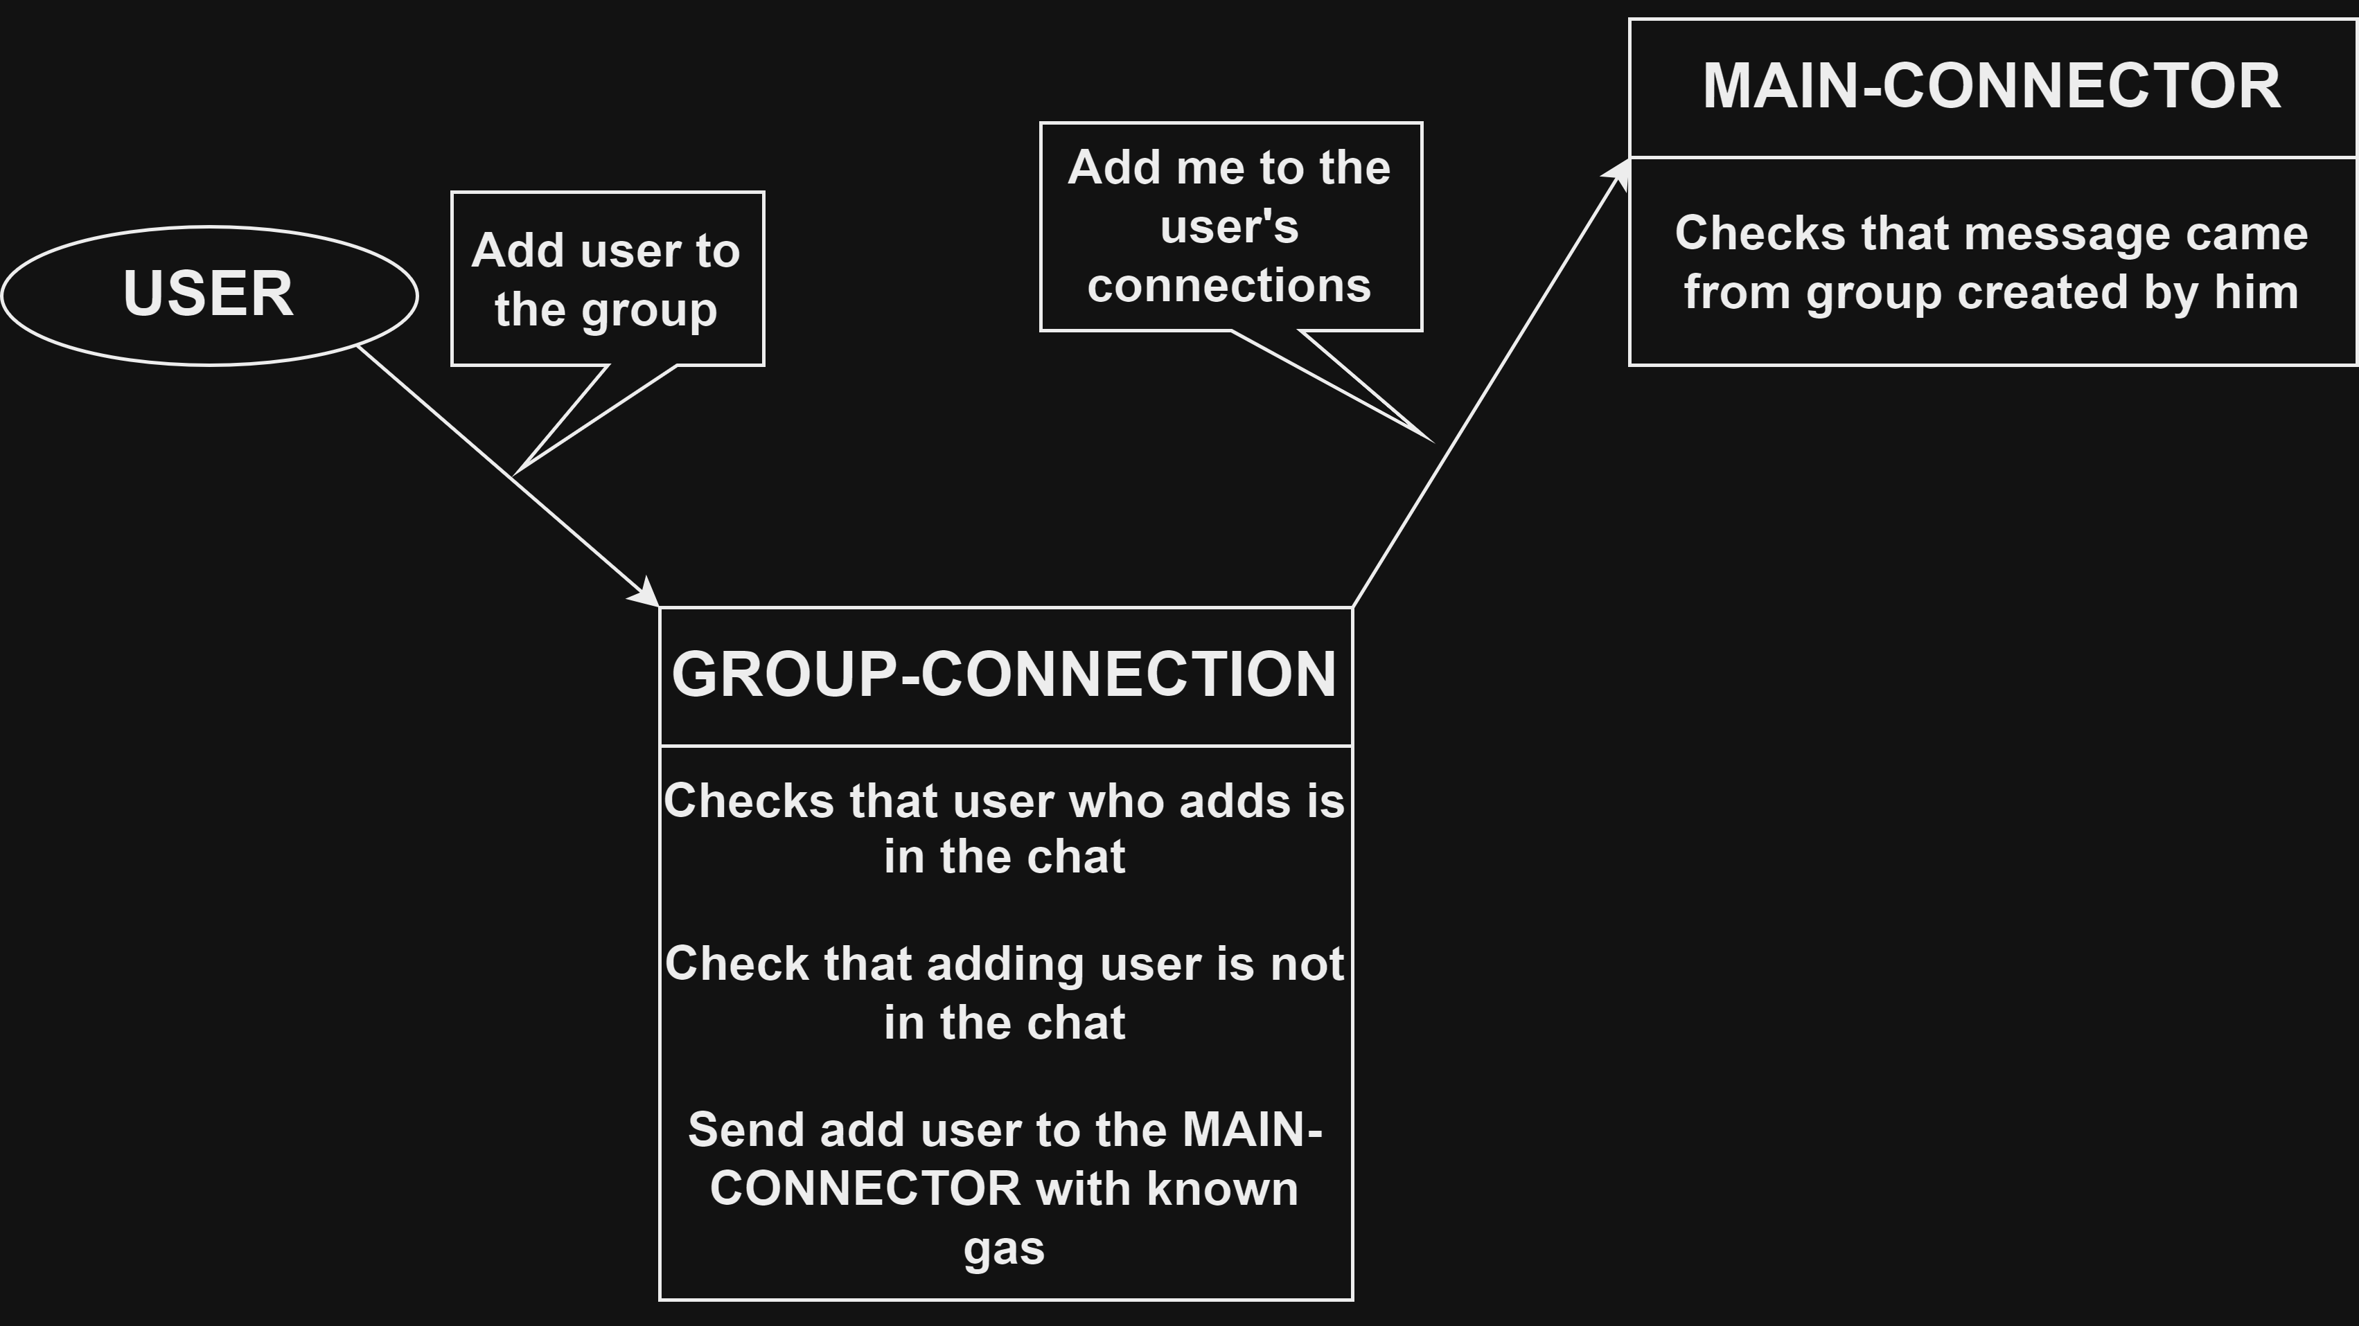
System consistency
(as system of smart contracts, no as a whole messenger dapp)
The only inconsistency can occur when we out of gas, but we handle it by sending with gas
We don’t need reply_deposit or system_reserve_gas since logic of adding group to user’s connections in MAIN-CONNECTOR as much simple as logic for handle_reply and handle_signal (if we implement them of course)

Slide 11
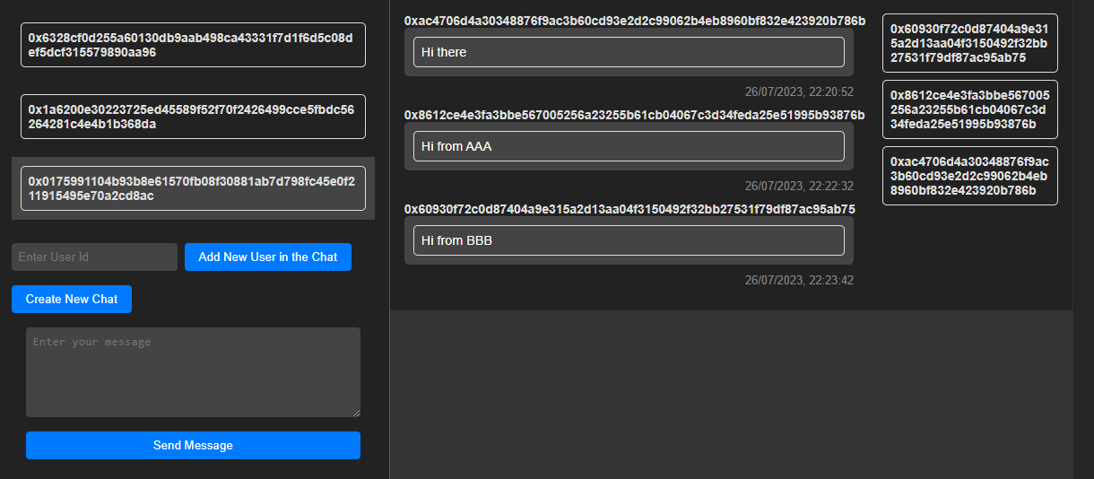
Messenger frontend
Functionality:
Send message to the chat
Add user to the chat
Create new chat
Show the content of the chat
Show user’s all chats
Register
Login

Slide 12
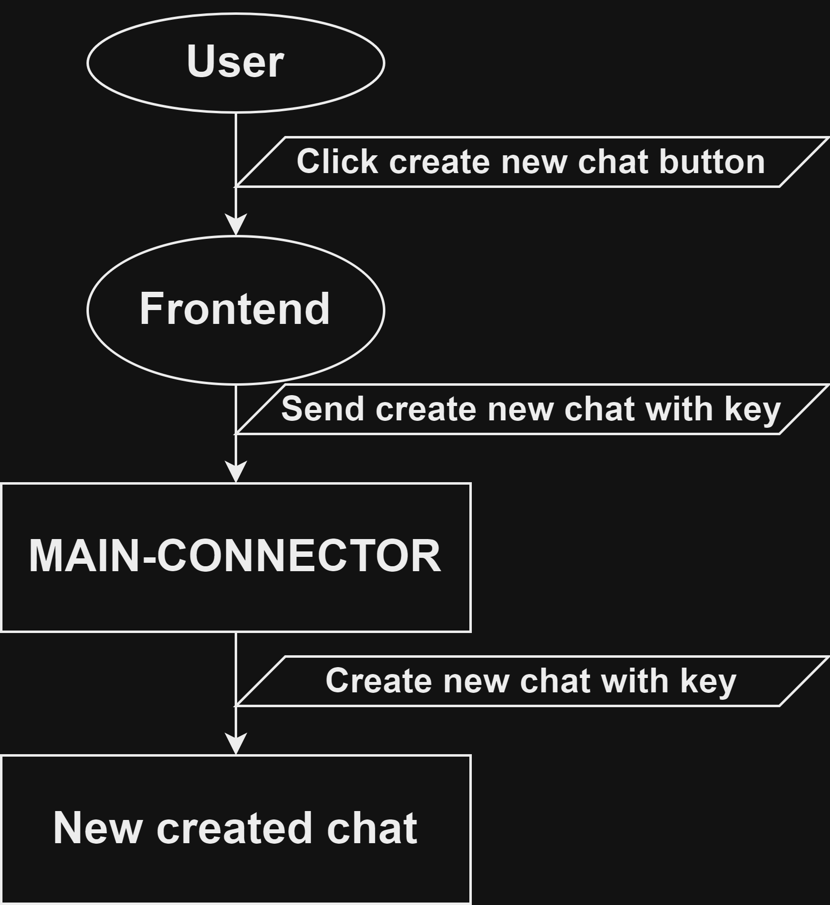
Create new chat
Generate random symmetric key
Get your public key from MAIN-CONNECTOR
Encrypt symmetric key by your public key
Send create new chat with encrypted symmetric key to the MAIN-CONNECTOR

Slide 13
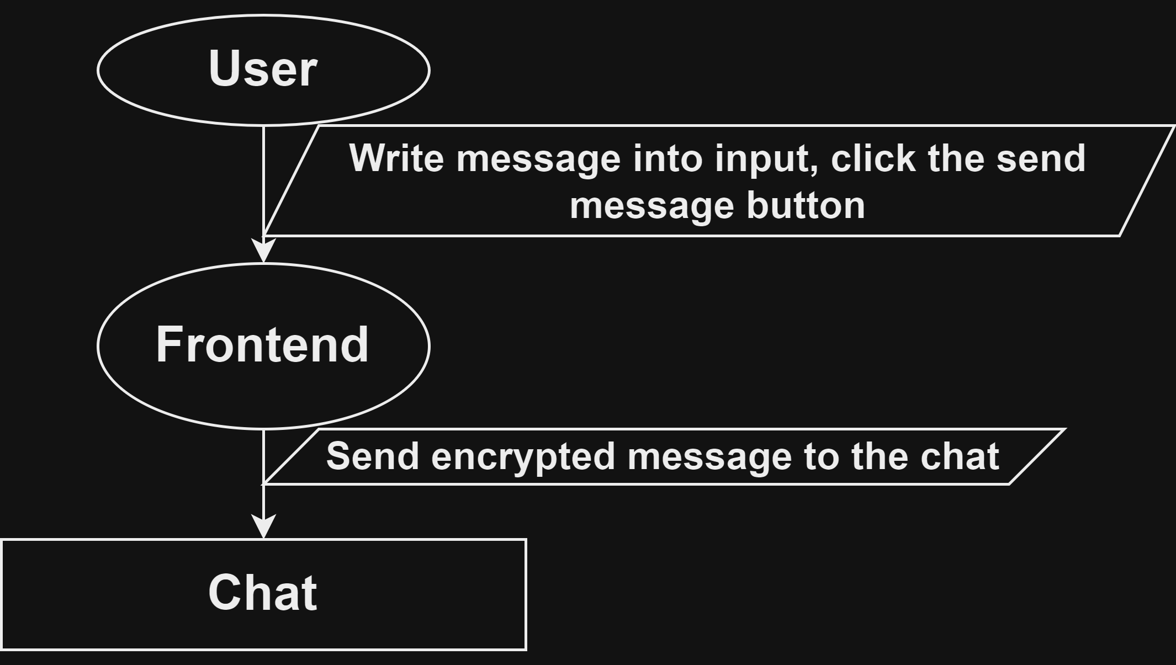
Send message to the chat
Get symmetric key encrypted by your public key from chat
Decrypt this key by your private key
Encrypt message by this symmetric key
Send message to the chat

Slide 14
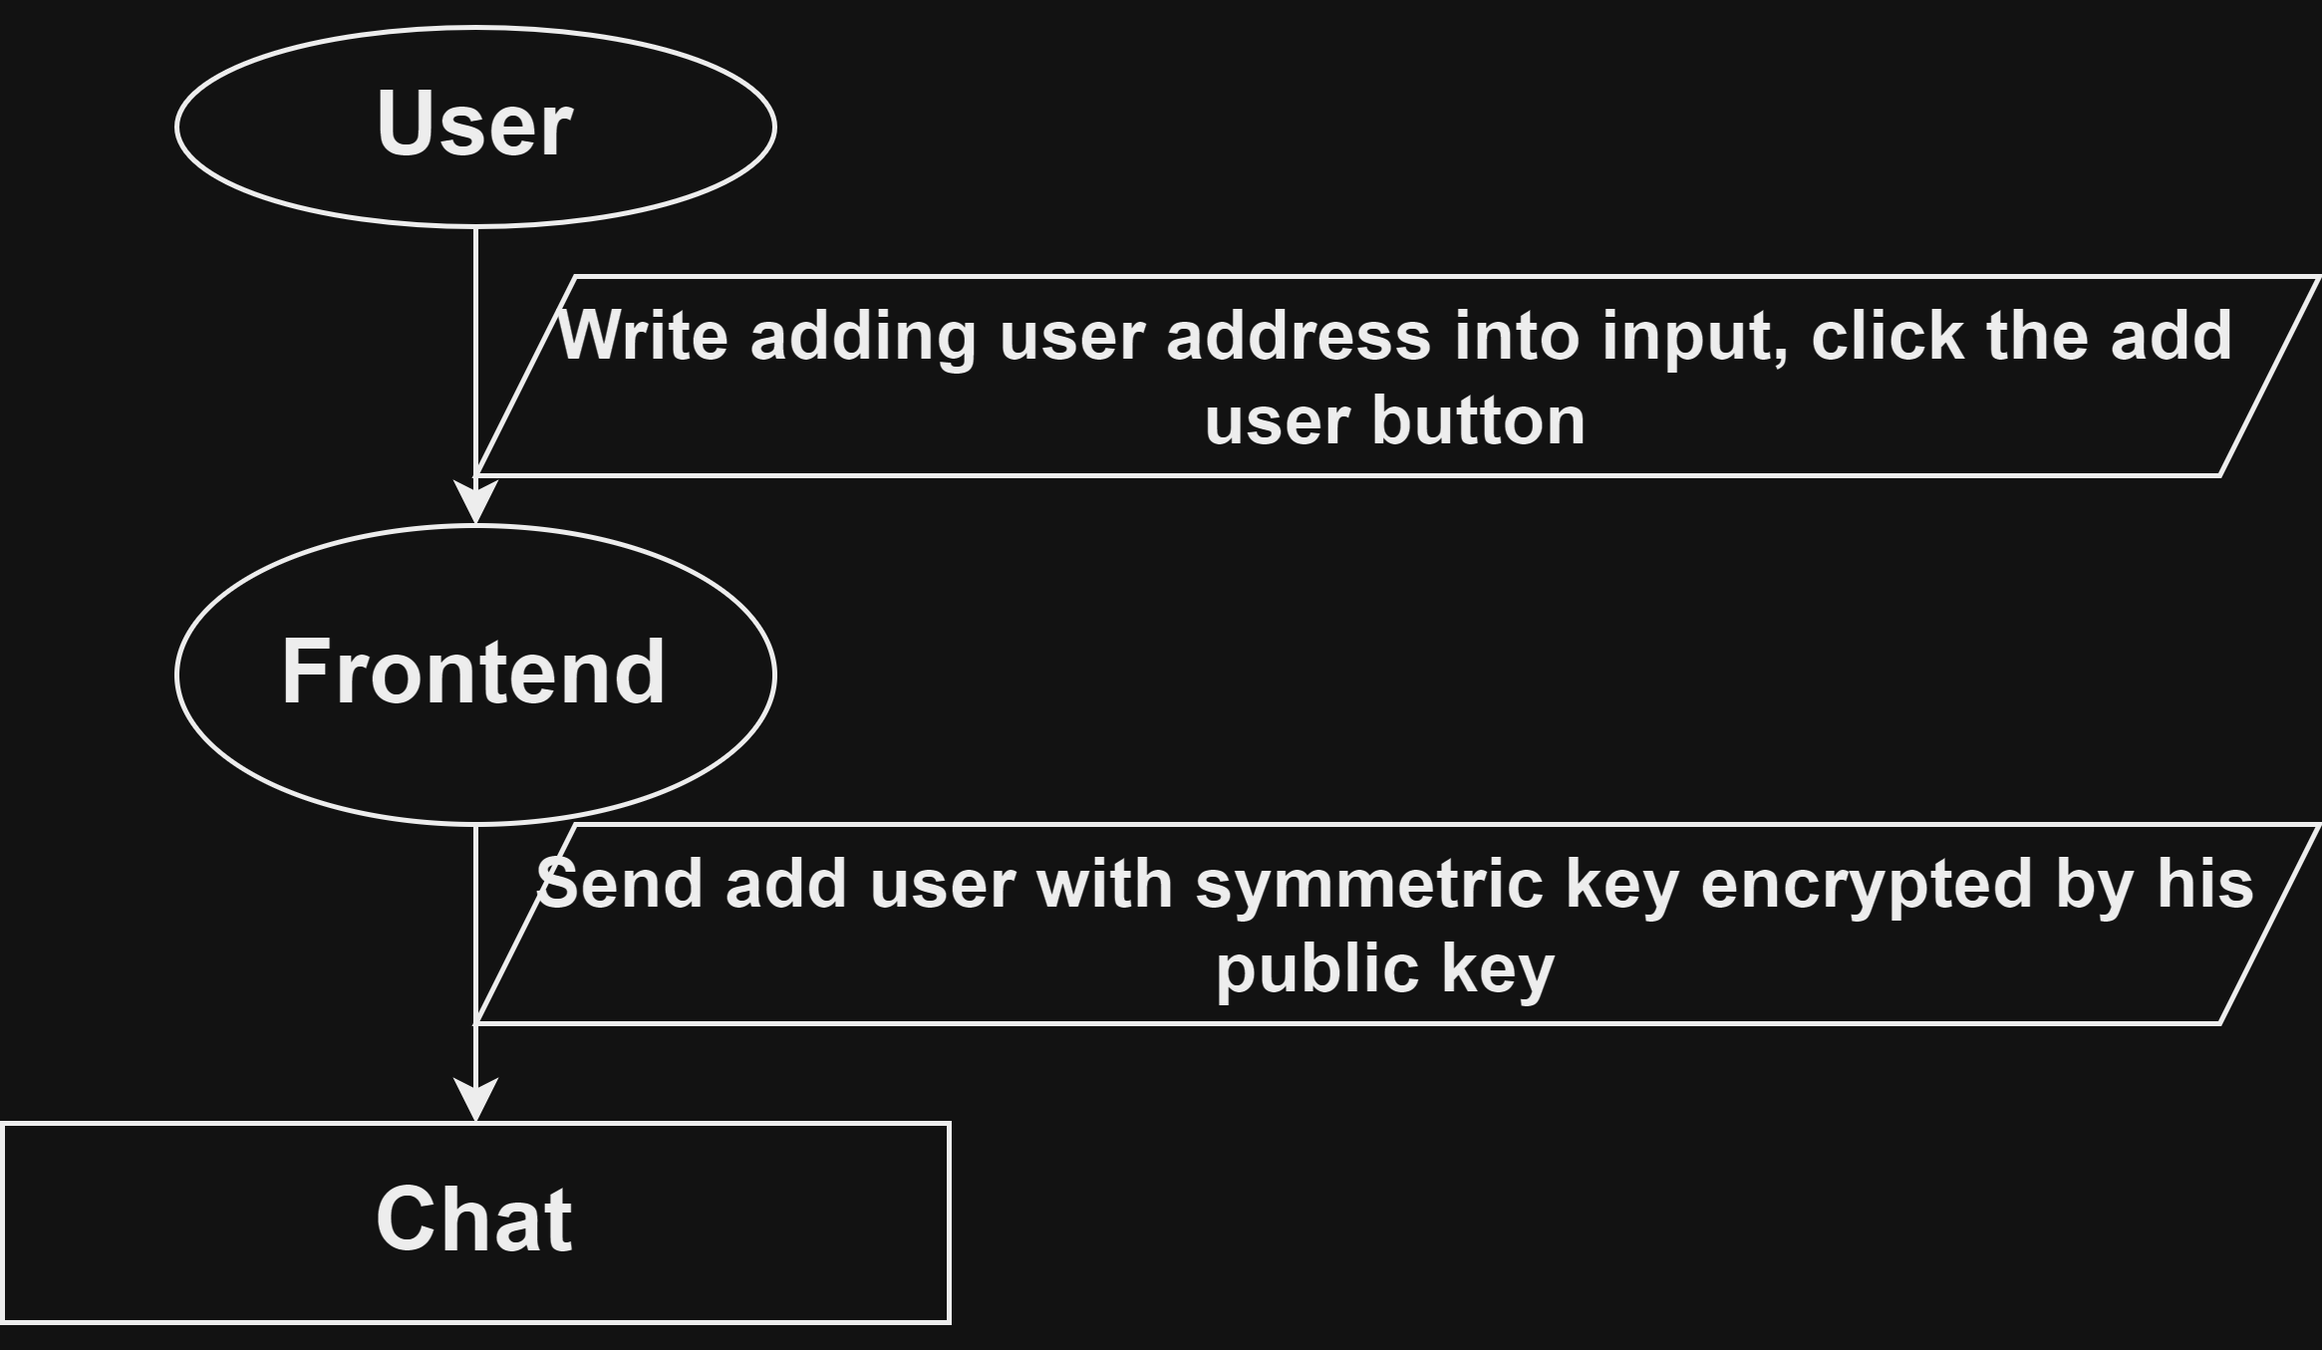
Add user to the chat
Get user’s public key from MAIN-CONNECTOR
Get your encrypted symmetric from chat
Decrypt key by your private key
Encrypt symmetric key by user’s public key
Send add user with encrypted symmetric key to the chat

Slide 15
Show the content of the chat
Get symmetric key from chat
Get encrypted content
Decrypt it
Show all user’s chats
Get it from MAIN-CONTRACT

Slide 16
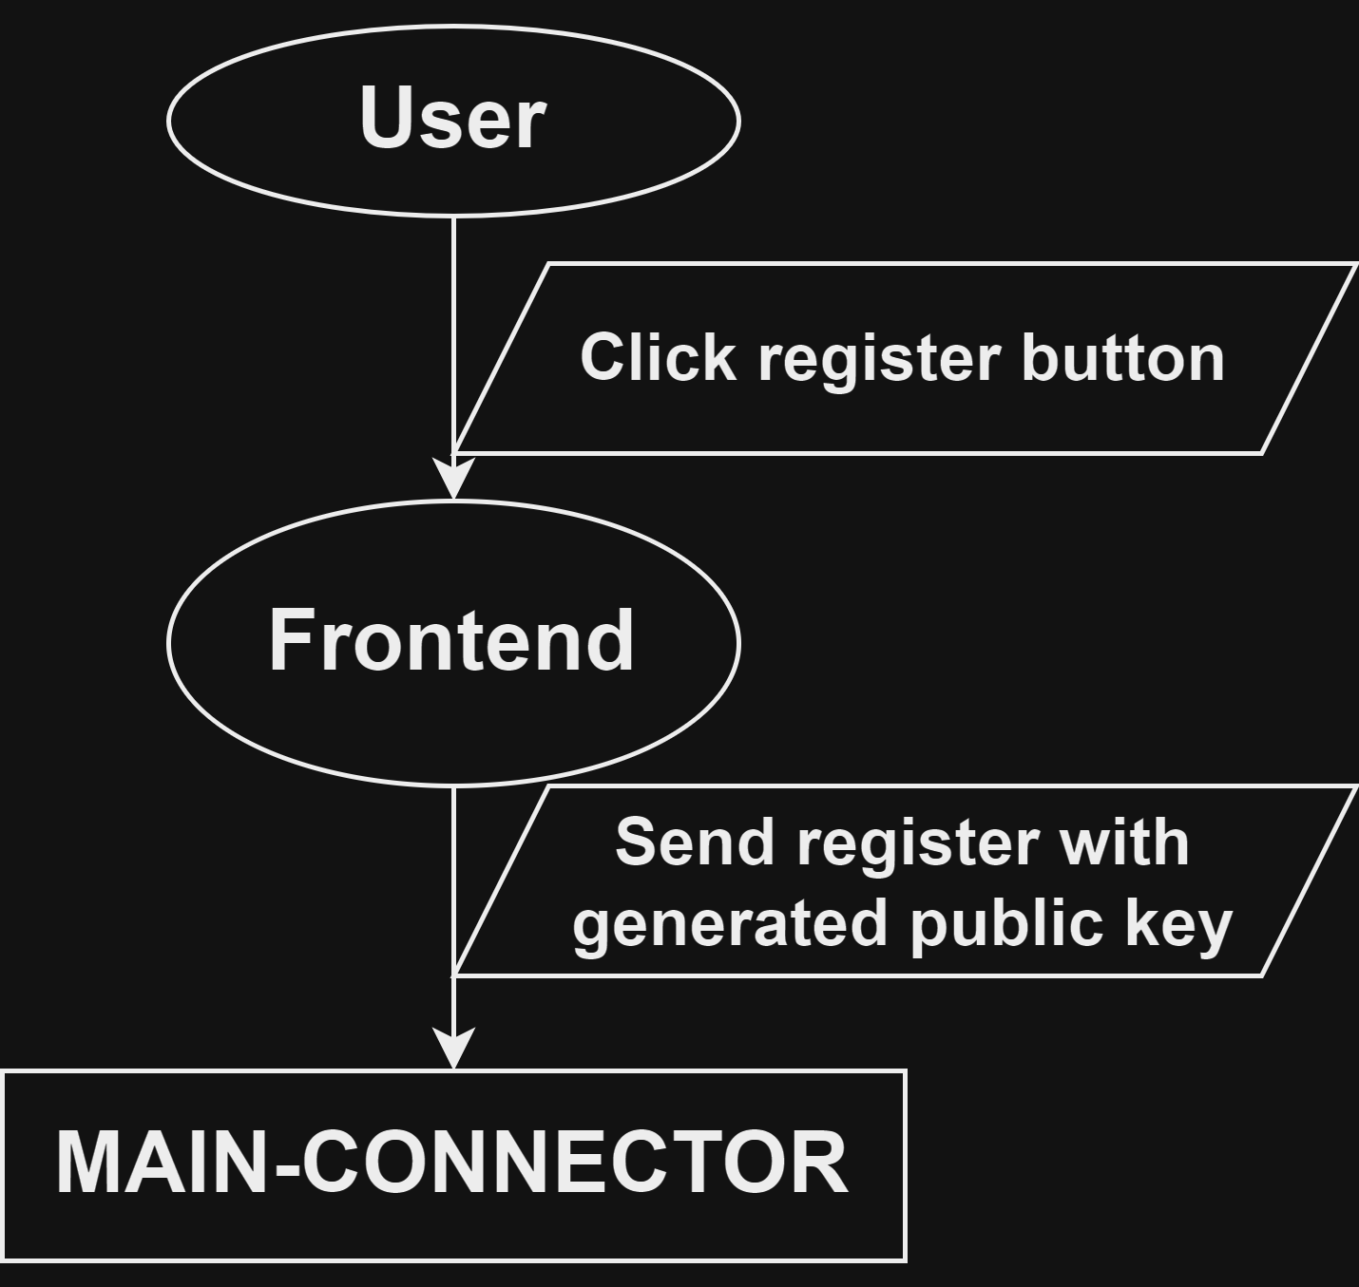
register
Generate random private public key pair
Store private key
Send register with this public key to MAIN-CONNECTOR

Slide 17
issues
Everyone can see with whom and how often you communicate (but they don’t see the content):
Can be solved by using new identity every chat creation
Actually we can use as private public key encryption decryption, keys from your wallet, but I don’t find any extension wallet which provide access to private key or at least give functionality to decrypt message by your private key:
If we can solve it, we don’t need that costly registration, and hence we can easily use new identity every chat creation
We can solve it by creating whole new system of identities with private public keys, so for that we must add sign functionality in our frontend in verify functionality in our chat contract, but it looks very unnecessary
State reading:
since Gear Protocol do not provide multiple functions for reading state, even if I need just read last message I still have to read full state, it really slows the messenger. Actually this is such a problem that it is probably better to abandon the creation of complex real-time responsive applications

Slide 18
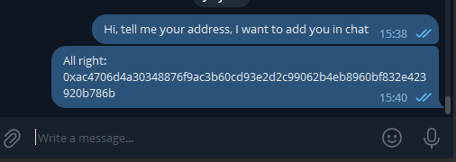
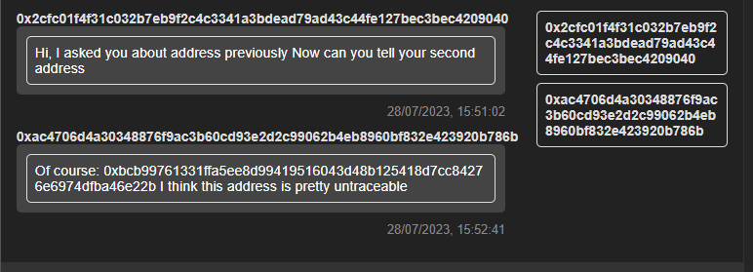
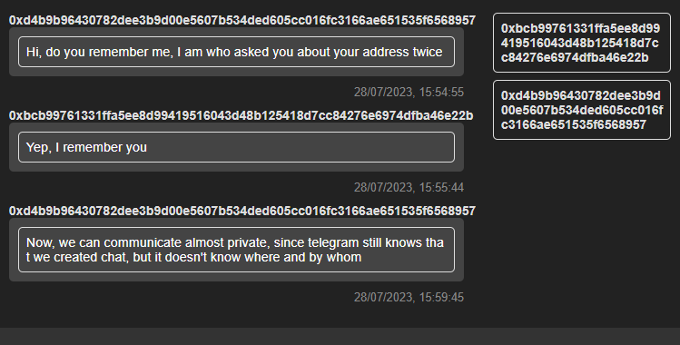
Example of Secure chat creation
Known messenger for communication
Chat used for secure chat creation
Secure chat

Slide 19
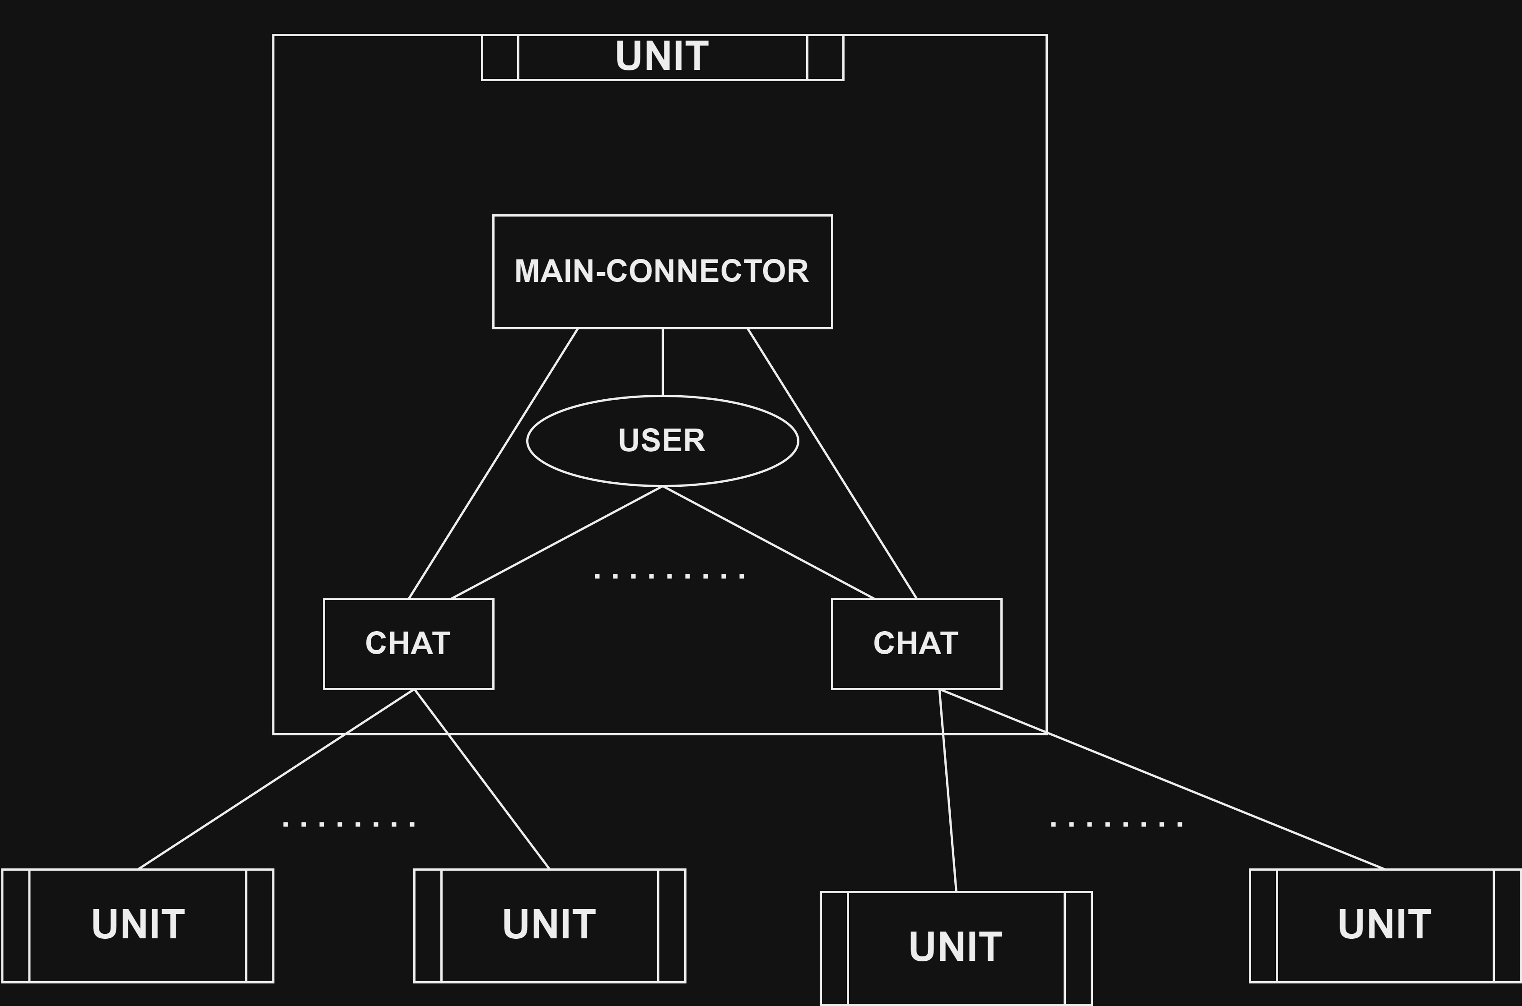
distributed messenger with Main connector for each user
Benefits:
MAIN-CONNECTORs for everyone:
Even more distribution
USER controls his own connector:
We don’t need send add user from chat to connector, we can handle consistentness from frontend
It adds even more distribution and a little simplifies chat contract logic
Does not solve previous issues

Slide 20
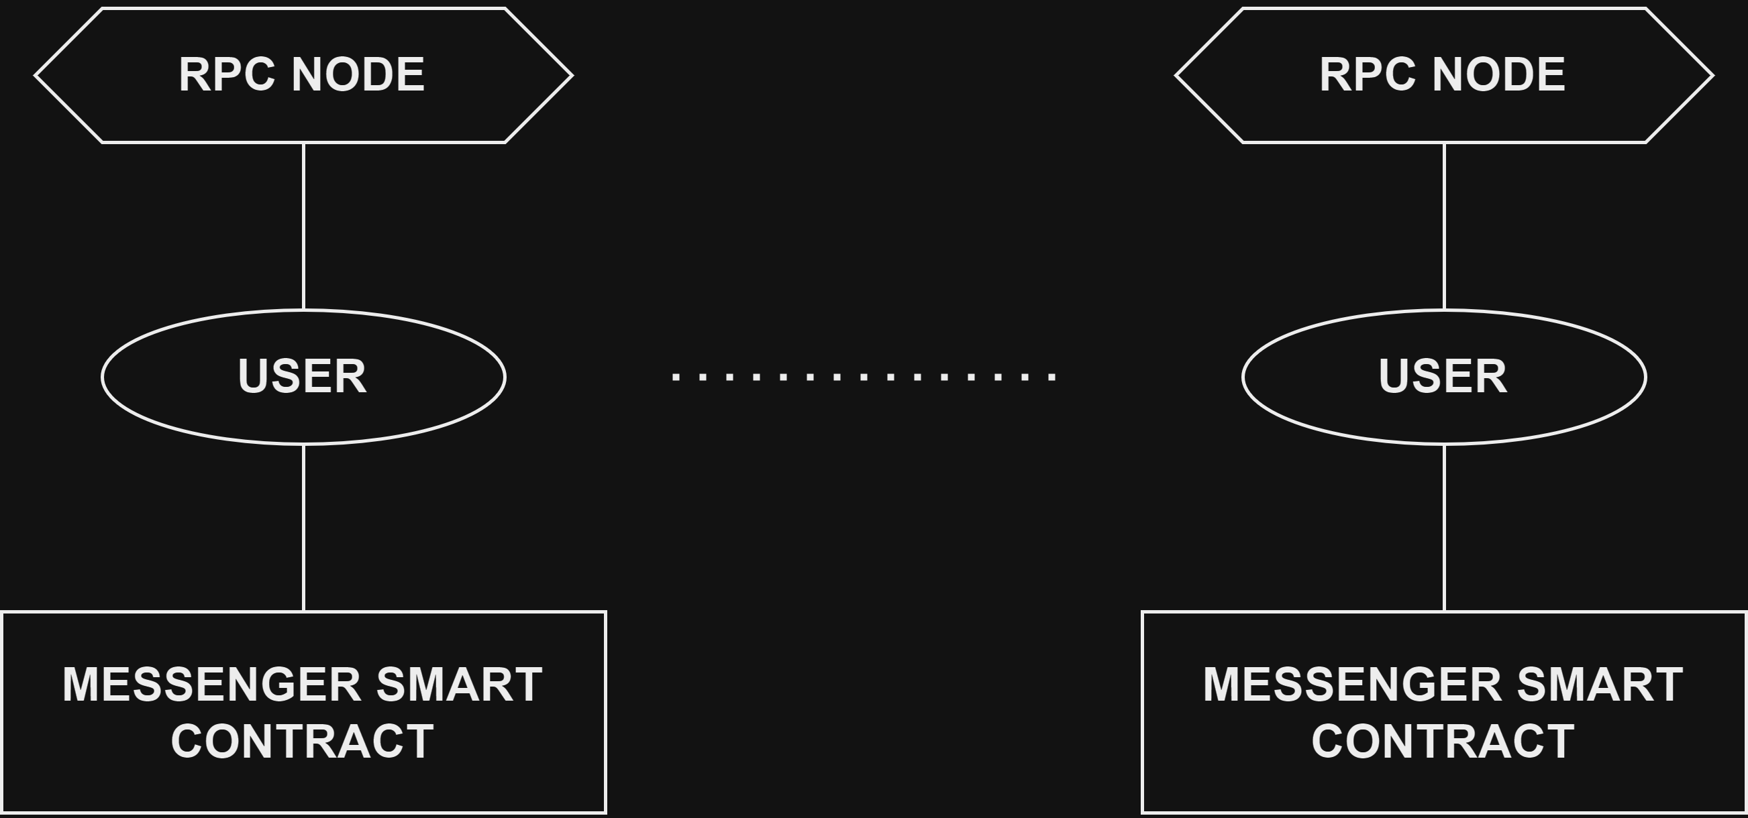
Distributed messenger with all in one contract for everyone
Solves all issues
Everything that the user does, he does exclusively in his contract

